Slide 1
Higgs Boson Challenge
Team:
1. Amey Bhatuse
2. Swarnava Bhattacharjee
3. Venkatesh BY
Univ.AI (AI1) cohort 5

Slide 2
Problem Statement
The events detected by the detector at the LHC in large majority, represent known processes(called background) that are mostly produced by the decay of
exotic particles.The search for new physics provided by unknown events (called signal) is difficult because these processes are rare.
Goal
Classification of events as signal and background dataset along with predicting the weights for the simulator and calculating the AMS(Approximate Median Significance)
Approach
To train a classifier on a simulated set of signal and background events that will be able to classify the events as signal and background and train a regression model for predicting the weights

Slide 3
DATASET
Simulated events from the official ATLAS full detector simulator containing the signal and background events
Types of variables
-Primitive (raw quantities measured by detector)
-Derived
Outliers in data:
(quantities computed from raw quantities)
Variables are floating point and have value -999.0 if they are indicated as
may be undefined
Samples
Training data samples = 250000 Testing data samples = 550000
Weights- describe the way the simulator works , so not to be used as features

Slide 4
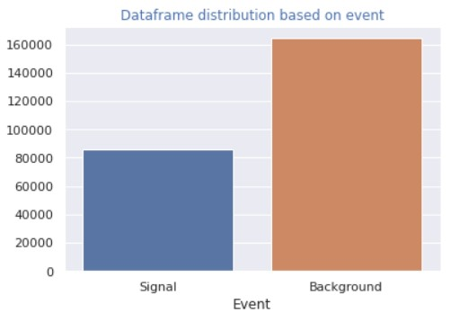
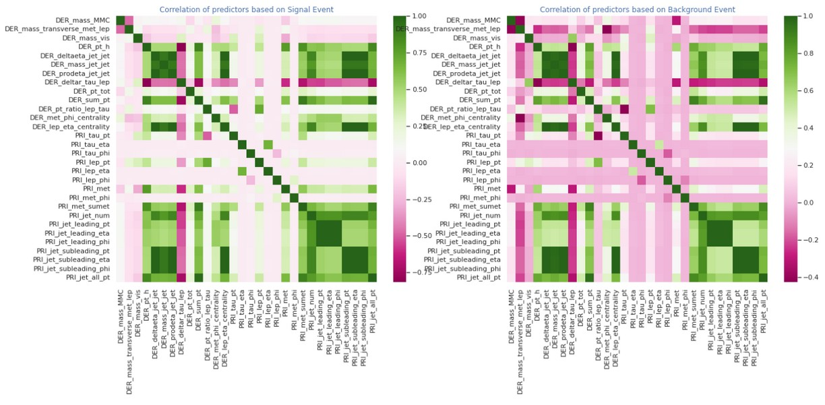
EDA(EXPLORATORY DATA ANALYSIS)
Separating the dataset shows that there is a significant class imbalance(~1:3) between signal and background events
Correlation of predictors based on signal and background events

Slide 5
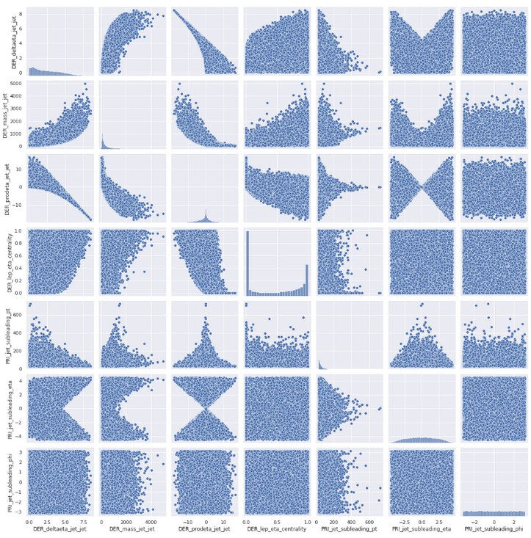
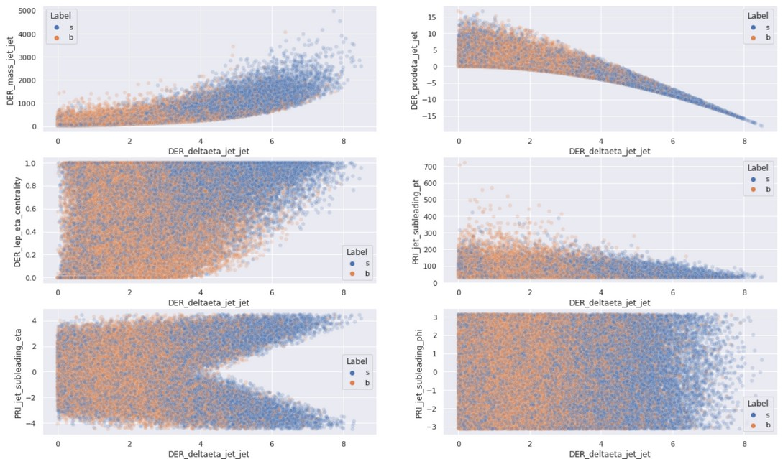
DATA CLEANING
-We are dropping those columns that have more than 60% outliers, i.e. have value -999.0 for
We trained the baseline model along with the dropped predictors and found no improvement, thus they are insignificant
-We standardize predictor variables and choose upscaling(SMOTE) as a method for imbalance
treatment
60% of the events
Correlation between dropped predictors
Collinearity between predictors

Slide 6
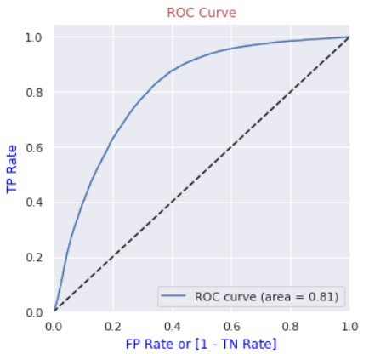
Model
We train four different models and try to tune their hyperparameters
-Logistic Regression(Baseline Model)
-Decision Trees
-Random Forest(Ensemble Model)
-AdaBoost
1.Logistic Regression(Baseline Model)
-F1 score = 0.75
-Area under ROC curve = 0.81
ROC curve for Logistic Regression

Slide 7
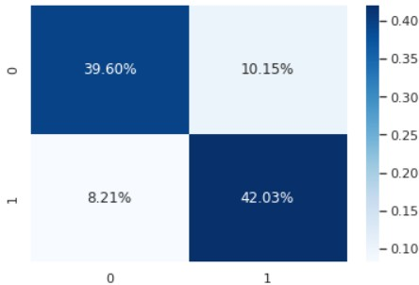
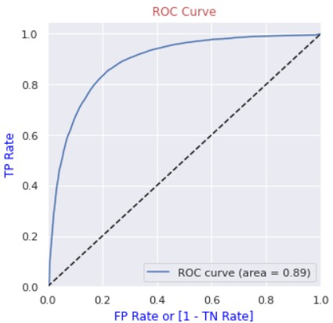
2.Decision Tree
-F1 score = 0.82
-Area under ROC curve = 0.89
After Hyperparameter tuning with GridSearch we found 11 as the ideal depth with minimum
samples as 5

Slide 8
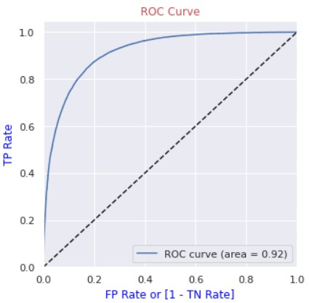
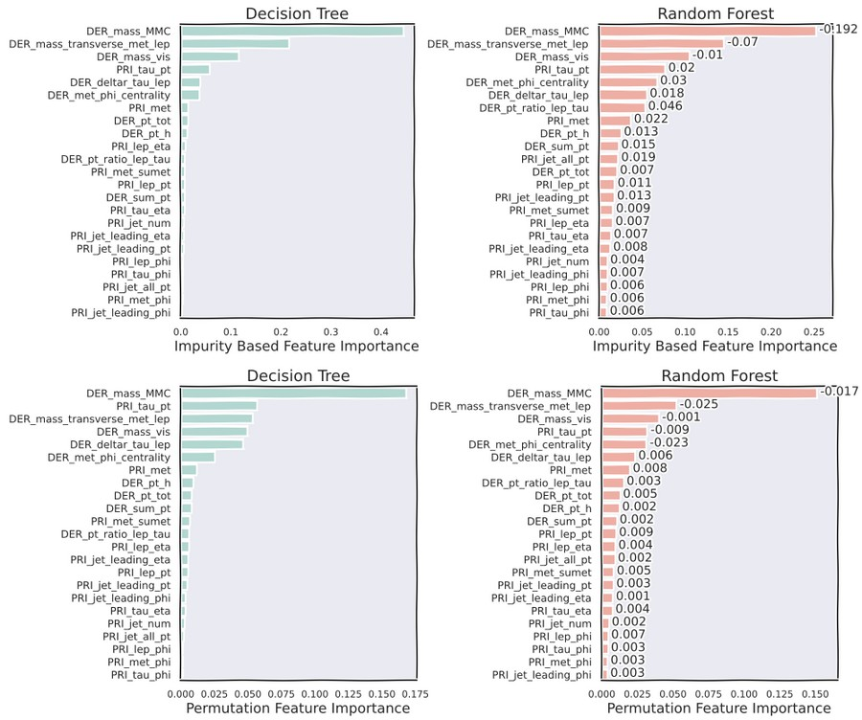
3.Random Forest (Ensemble Model)
with Grid Search
Best F1 score = 0.838 Best Configuration:
Maximum Depth: 15
Minimum Samples: 5 Number of trees: 50
Best AUC for RUC curve: 0.92
Most of the features are unimportant

Slide 9
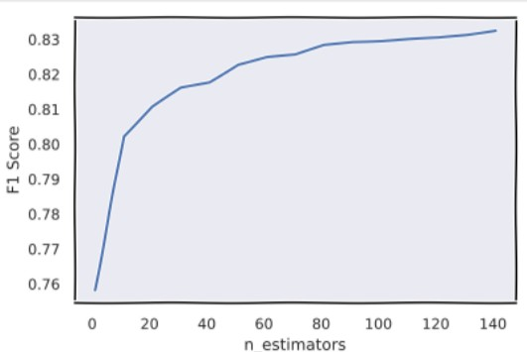
4.AdaBoost
Decision Tree with maximum depth of 2 as a weak learner F1 score for weak learner = 0.758
We encounter an almost plateau region for the F1 score when the number of estimators become more than 100
f1_score after boosting the weak learner = 0.83
AUC for ROC = 0.91

Slide 10

Experimention/Observation
Label
ROC(AUC) for ADABoost with Hyperparameter tuning is 0.91 which is nearly same for hyperparameter tuned Random Forest model. However, the computational cost for AdaBoost is considerably higher than Random Forest
Weights
Linear Regression(Baseline Model)
-R2 score on Train data : 0.4616
Decision Tree Regressor
-R2 score on Train data : 0.6513

Slide 11
Model Selection
Label
We choose Random Forest model with AUC for ROC as 0.92 as our final model for the classification of signal and background events
Weights
We choose the Decision Tree Regressor with R2 score 0.6513 as the best model for predicting weights

Slide 12

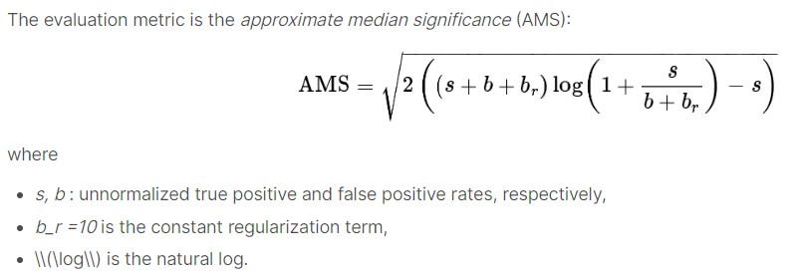
Prediction on Unseen data
We performed the same preprocessing on the test dataset as the train dataset We classified the events as signal and background events for the test dataset
AMS(Approximating Median Significance)
We calculated AMS from predicted label and merged with the test dataset and submitted the .csv file as output

Slide 13
Thank you!

